Slide 1
FACILITATION WITH YOUTH
Chanelle Ramiro, Youth Educator (I Lina'la-Hu)
Troy Cruz, Youth Educator (Project Isa-Ta: PREP PATHways)

Slide 2
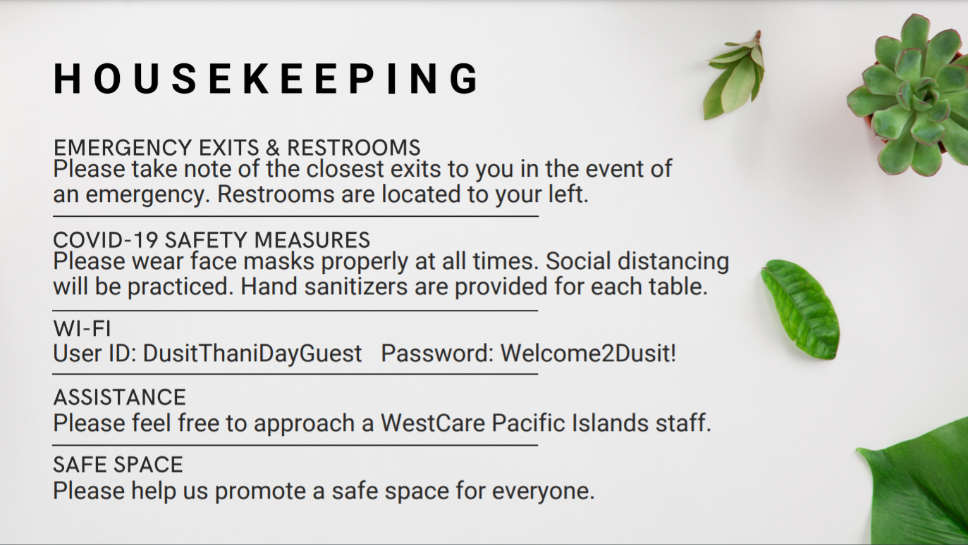
Notes:
House Keeping Slide Reminder

Slide 3
someone who helps to bring about an outcome (such as learning, productivity, or communication) by providing indirect or unobtrusive assistance, guidance, or supervision
facilitator
Notes:
What is the essential role we play as facilitators?
How does this role differ from that of other leadership or guidance roles that adults play in the lives of youth?

Slide 4
Facilitating vs. Teaching
What are the similarities?
What are the differences?
What are the challenges?
CHANELLE
Notes:
Keep these questions in mind

Slide 5
Promote empathic listening and critical thinking by asking youth for their ideas and engaging them in discussions
CHANELLE
Notes:
In a few moments we want to have you all work on a quick activity to sort of answer the questions that were posed on the previous slides in the terms of the role of a facilitator But before we do that –Facilitator's job is to share and be A PART of the process.
We are here to promote empathic listening and generate critical thinking
Youth may know the answers; allow them to draw conclusions on their own; guide as necessary
What we do as facilitators can positively influence the youth's thoughts and behaviors. Because the adolescent brain is actively forming, good facilitation can promote critical thinking and provide mental and relational opportunities that literally develop neurological pathways in the brain.
One of the most important things we can do is ask questions in a thoughtful and skillful manner and listen carefully.

Slide 6
Facilitator Is / Is Not
Notes:
*Activity

Slide 7
A Facilitator
Is...
Role Model, w/ Use of Self
Resource for information, referrals
Leader, Authority Figure
Witness
One who encourages
One who stimulates thinking
Guardian of the group
Listener and Communicator
Protector, Responds to Crises

Slide 8
A Facilitator
Is Not...
Therapist
Parent
Peer
Analyst, Interpreter
Judge, Critic
Evangelist, Preacher
Expert
Sole Authority
Advisor, Problem Solver

Slide 9
PRIMARY RESPONSIBILITY:
Provide Safe & Brave Spaces
Physical Safety
Emotional Safety
Social & Cultural Safety
TROY
Notes:
What does physical safety look like?
"
"
Social/Cultural Safety also falls into the category of learning their cultural/social practices (ex: Not speaking at a female)
Cultural Safety – Allow youth to incorporate culture into classes
Ex: Identifying warning sign activity As facilitators, and as people, the learning never stops – We are here to share with you, but for the area of safety, what better way to learn than from a room of your peers and like-minded individuals or
Bridge – Now that we have identified the safety’s needed for youth lets discuss what roles we play for them as a facilitator

Slide 10
STRIVE TO GENUINELY EXPRESS YOURSELF WHILE SETTING LIMITS AND BOUNDARIES AROUND PERSONAL OR SENSITIVE INFORMATION
WHO BENEFITS?
HOW WILL THEY BENEFIT?
AUTHENTICITY
WHOSE NEEDS ARE BEING MET?
Notes:
Express yourself genuinely
In general, an effective group recognizes the significance of authentic relationships b/w caring adults & youth. A common concern for group facilitators is the question of self-disclosure

Slide 11
LEGAL & ETHICAL CONSIDERATIONS
RESPONDING TO HARMFUL OR DANGEROUS CIRCUMSTANCES
MAKING APPROPRIATE REFERRALS WHEN NEEDED
CONFIDENTIALITY AND ITS LIMITATIONS
TROY
Notes:
Bridge – When setting limits and boundaries it’s an advantage to explain those expectations at the formation of your groups
ex: Effective way to set the expectations: Facilitator signs an agreement and holds themselves accountable as well as the youth
What is okay to share? What is not okay to share?
Mandated Reporting
Make your expectations clear at the beginning of your group
Should something come up in the future, they are not blindsided by you
It may be their way to indirectly reach out to you through sharing
Prepare your crisis hotline, contact referrals beforehand
Follow the protocols of your organization and at the site you may be at

Slide 12
THINGS TO KEEP IN MIND
01.
Know Your Content
02.
Get Comfortable with your space. Own it!
03.
Know your filler words
04.
Pace Yourself
05.
You can always go back
06.
Know when to redirect the energy
07.
Acknowledge and affirm input
08.
Mind your words
Notes:
Redirect energy/own your space
Don’t be afraid to walk around
Pace Yourself = be comfortable in Silence
Silence does not mean they aren't paying attention; don’t rush
Silence may mean they are processing what your question
Set the tone of comfortability
PREFACE is an undervalued method; allows youth to get mindset ready for topic ahead
Read the room – if a stretching activity or icebreaker is needed then take time to conduct one to change the energy
Acknowledge and affirm "Thank you for your input" "That’s one perspective thank you. Does anyone have another?"

Slide 13
Show Us
What You're Working With
Choose an item
You will be given 5 minutes to prepare a presentation on the many uses of this item.
The sky is the limit!
Make sure to engage your audience
Notes:
1 person from each table will present
Gauge based on time
4 max

Slide 14
THINGS TO KEEP IN MIND
01.
Know Your Content
02.
Get Comfortable with your space. Own it!
03.
Know your filler words
04.
Pace Yourself
05.
You can always go back
06.
Know when to redirect the energy
07.
Acknowledge and affirm input
08.
Mind your words
Notes:
Redirect energy/own your space
Don’t be afraid to walk around
Pace Yourself = be comfortable in Silence
Silence does not mean they aren't paying attention; don’t rush
Silence may mean they are processing what your question
Set the tone of comfortability
PREFACE is an undervalued method; allows youth to get mindset ready for topic ahead
Read the room – if a stretching activity or icebreaker is needed then take time to conduct one to change the energy
Acknowledge and affirm "Thank you for your input" "That’s one perspective thank you. Does anyone have another?"
Ex of Minding Your Words - "Sir/Ms. have you done that?"

Slide 15
Let's Move It!
Name Game
Notes:
When

Slide 16
STAGES OF GROUP FORMATION
1. FORMING
2. STORMING
3. NORMING
4. PERFORMING
5. ADJOURNING
(Tuckman, 2001)
Notes:
Bridge – Activity completed is an effective icebreaker at the beginning of your group

Slide 17
Forming
FEELINGS
COMMON ISSUES
YOUR ROLE
Negativity
Dissatisfaction
Frustration
Unproductive argument
Competition for leadership and influence
Not listen to each other
Know your youth
Maintain balance
Maintain positive tone

Slide 18
Storming
FEELINGS
COMMON ISSUES
YOUR ROLE
Youth are not familiar with or trust one another
Goals and Roles can be confusing
Group is dependent on facilitator
Anxiety
Excitement
Fear
Exploring
Listen reflectively
Observe the youth/group
Be patient and guide

Slide 19
Norming
FEELINGS
COMMON ISSUES
YOUR ROLE
Relief and renewed confidence
Increased caring
Cohesion around shared goals
Fear of rejection is lessened
“Us” vs. “Them” mentality
Youth/Group confidence in its ability to identify problems or create solutions is viable
Patience & Guidance
Challenge the Youth’s intellectual & emotional boundaries
Trust the group and let go of some control
Manage conflict
Attend to issue honestly and directly

Slide 20
Performing
FEELINGS
COMMON ISSUES
YOUR ROLE
Trust
Greater levels of honesty and connection
Confidence
Pride
Not sure how to self-evaluate
Remain aware and monitor progress
Trust the group process
Stay attentive

Slide 21
Adjourning
FEELINGS
COMMON ISSUES
YOUR ROLE
May feel like short timers
Separation from the group
Happiness or Satisfaction
Regression Behavior
Resistance to the Facilitator
Lack of Interest
Be present
Understand the regressive behaviors

Slide 22
Managing the Group
Notes:
Going back to the role of a facilitator – managing the group is crucial to facilitating skills as strong personalities can easily overtake a presentation or an objective.

Slide 23
Quiet Person
Establish eye contact
Ask directly in non-confrontational way
Talk with them individually to brainstorm ways they can be comfortable in the group
Do small steps. Praise and reinforce.
Talking stick
TROY
Notes:
Groups : Diad/Triad
Confirmation of right to pass or present (Works virtually) - have them express themselves, they may feel intimidated by other who share

Slide 24
Over-Talker
Remind the group about the guidelines
Be assertive and gentle
Works in pairs or small groups
Give timeframe to clarify expectations
Speak to them individually
Give them a responsibility
CHANELLE

Slide 25
Off-Topic
Redirect the conversation
Gently remind the group
TROY
Notes:
Seek examples from the crowd. Ask how they engaged with this particular youth?
View recording for the nugget

Slide 26
Distracting
Use a direct approach
Use “I” statements
Remind the group about the agreement
Speak to the youth after the group
TROY
Notes:
Seek examples from the crowd. Ask how they engaged with this particular youth?
View recording for the nugget

Slide 27
Advice Giver
“Have you experienced that? If so, how was it resolved?”
Help the group become aware of difference between advice-giving and listening
Notes:
Seek examples from the crowd. Ask how they engaged with this particular youth?
Not every scenario plays out the same way
Temptation to answer the question “have you done it sir/ma’am”
“I was a youth once and I empathize with the emotions you're currently feeling. We’re not hear to give you advice or to tell you what to do next. We are here to provide you with the information to make a responsible choice for you.”
Goes back to your role as a facilitator and the difficulty that lies between self-disclosure from you and trying to build rapport

Slide 28
No Interest
“What can I do to make it better/easier for you?”
Acknowledge and empathize
Look for their passions and interest
Thank them for being there
CHANELLE

Slide 29
Prejudice
Take it as an opportunity to challenge assumptions
Be aware of your own biases and values
Encourage and develop activities that honor diversity
CHANELLE
Notes:
Lastly --- for me, as a facilitator one of the things that stands out the most is the notion of power, privelege, and prejudice.
And as a facilitator – biases, power, privilege – those are a few of the things that should be what facilitators should be thinking about.
So there are some myths surrounding facilitation and the roles and duties of a facilitator and the ones that stound out to me the most is the role in managing conflict/discomfort – and while managing group dynamics is one of the many roles of a facilitator – we need to recognize that majority of that discomfort is held or experienced by those holding marginalized identities --- whether they be social identities, gender identities, cultural identities, etc..... --- and so for example one of the things that I love and is relatively new to me --- is on our registration forms for our youth programs – we don't have a "circle M/F gender binary option" we have a blank line --- One of the ways can we can really encourage and honor diversity is in the very simple way we open our groups or introduce ourselves,
Setting the expectations at the formation of your groups
Using and identifying pronouns (he/him/his) (she/her/hers) (they/it/)
Some youth may identify as LGBTQ

Slide 30
Q&A
TECHNIQUES
CHANELLE
Notes:
When dealing with these personalities and the challenges you may face, lets focus on the Q&A techniques that may be helpful for your group Handling and using questions is an extremely useful tool in a facilitative environment. By using questions skillfully, you can bring out your audience by: provoking thought and arousing interst, broadening discussion, stimulating participation, and creating a listening environment.

Slide 31
2 Techniques:
Open-Ended Questions: Who, What, Where, When, Why, How, Tell me…
Close-Ended Questions – Use sparingly!
Notes:
Open-ended allows for critical thinking and original ideas
Close-ended usually seeks affirmation: YES or NO
Ex: Are you good? Vs How are you feeling today?
Ex: Do you like sports? What sports interest you?
Questioning is a critical skill in creating a facilitative group environment. Use a combination of questions to reach the learning objective. You can use questions to accomplish your objectives in any given topic.

Slide 32
TAKE COMFORT IN SILENCE
Ask a question. Leave it to the space.
ASK and be still.
CHANELLE

Slide 33
START BIG
before
small
going
Notes:
Start with general questions
Then move to more specific or personal
Asking participants to take less risk while first answering more general questions that apply to a larger audience

Slide 34
What is a healthy relationship?
Tell me some examples of what is not in a healthy relationship.
Why should it be important for you to be in a healthy relationship?
How can you make sure you are in a safe and positive relationship?
TROY
Notes:
It is important to be a good listener whne you use open questions. If you have a learning objective, being a good listener enables you to identify responses that lead the group in the direction that further develops the theme or objectives of the discussion. [see example]

Slide 35
RECAPPING FACILITATION

Slide 36
A Facilitator
Is...
Role Model, w/ Use of Self
Resource for information, referrals
Leader, Authority Figure
Witness
One who encourages
One who stimulates thinking
Guardian of the group
Listener and Communicator
Protector, Responds to Crises

Slide 37
THINGS TO KEEP IN MIND
01.
Know Your Content
02.
Get Comfortable with your space. Own it!
03.
Know your filler words
04.
Pace Yourself
05.
You can always go back
06.
Know when to redirect the energy
07.
Acknowledge and affirm input
08.
Mind your words
Notes:
Perfect Practice Makes Perfect = for us to feel confident in our training we must practice repeatedly to get better
Stop at know your filler words --- activity Redirect energy/own your space
Don’t be afraid to walk around
Pace Yourself = be comfortable in Silence
Silence does not mean they aren't paying attention; don’t rush
Silence may mean they are processing what your question
Set the tone of comfortability
PREFACE is an undervalued method; allows youth to get mindset ready for topic ahead
Read the room – if a stretching activity or icebreaker is needed then take time to conduct one to change the energy
Acknowledge and affirm "Thank you for your input" "That’s one perspective thank you. Does anyone have another?"
Ex of Minding Your Words - "Sir/Ms. have you done that?"

Slide 38
ACTIVE
LISTENING
CHANELLE
Notes:
Bridge – Now that we know the kind of questions to ask, how do we put them into play? This essential skill promotes empathy, builds safety, and develops strong connections within the group.

Slide 39
WHY
Invites Self-Expression, trust, and demonstrates you care
CHANELLE
Notes:
We think faster than we can speak
We haven’t been taught or learned the proper listening skills

Slide 40
Focus your attention on the speaker
Suspend all judgment
Listen for emotions
1
CHANELLE
Notes:
Eye contact may not be completely necessary. Sometimes can be awkward for one or both parties.
Recommended to face your body and attention to them as much as possible.

Slide 41
Verbally re-state to him/her what you have just heard them say
Avoid interpretation
Check with them for accuracy
Alternatively, ask the group to re-state the speaker’s message
When the speaker has made their point
2
CHANELLE
Notes:
So what I'm hearing is.....
So what your saying is... and please correct me if Im wrong or if I misinterpret
So it sounds like you...... is this correct?
So what Ive gathered from you is …...
So I noticed while you were talking that.... [noticing actions (Ex: nonverbal cues, fidgeting, eye contact or lack of, pacing, tone of voice)]

Slide 42
Let’s Practice!
Grab a partner
Notes:
Two sets of volunteers
Give leading examples so that we can gauge the active listening and prevent rambling or improvising
Ex 1: My dog ran away (dog is considered family)
Feel like losing hope because you have been looking for weeks
Posted signs and social media posts
Ex 2: My friends said some hurtful things to me
I don’t think they know that they hurt my feelings
I want to let them know but I don’t want to make it a big deal

Slide 43
How was that experience for you?
What are some things you can take away from that experience?
What are some things you can take into your present/future groups?
Reminder:
Feedback is feedback
Collaborate/network
Let’s Discuss!
Notes:
How was that experience for you?
What are some things you can take away from that experience?
Reminder: Feedback is Feedback What are some of the things that you can take into your present or future groups?
Don’t be afraid to collaborate or network for activities and strategies when it comes to facilitation skills or activities

Slide 44
Thank you!
Notes:
Please use phones for virtual Survey
Show completion of survey to check in table
Pick up your tote bags and incentives
Ask any WPI staff if you have questions or need assistance

